Slide 1



Welcome FEs!
Presenting You...
VESIT SPORTS COUNCIL

Slide 2

Welcome To VESIT!
Greetings, First-Year All-Stars,
Get set for an incredible journey with VESIT Sports Council! We're all about sports, fitness, and a fantastic time. Whether you're a sports enthusiast or simply curious, there's something special waiting for you.
Join us in creating memorable experiences, forging new friendships, and achieving your personal best. We're more than just a council; we're a family of spirited individuals passionate about sports and personal growth.
Your adventure starts now. Let's hit the fields, court, and track together, pushing boundaries, and crafting memories that will last a lifetime. Welcome to the VESIT Sports Council, where greatness begins!

Slide 3
The Sports Council of VESIT
The VESIT Sports Council is the heart of our sports community, and it consists of dedicated individuals in key positions:
Secretary
Senior Deputy Secretary
Junior Deputy Secretary

Slide 4

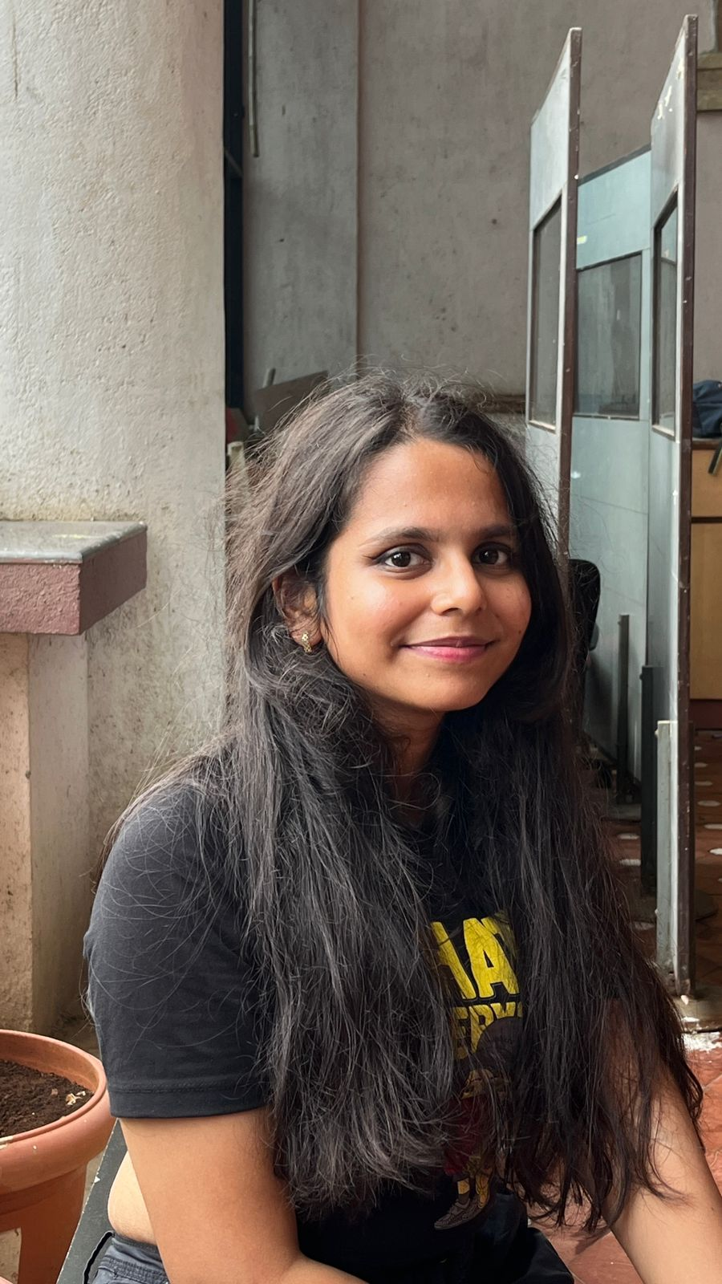
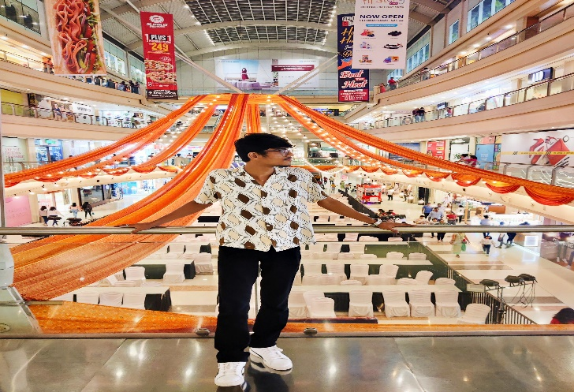
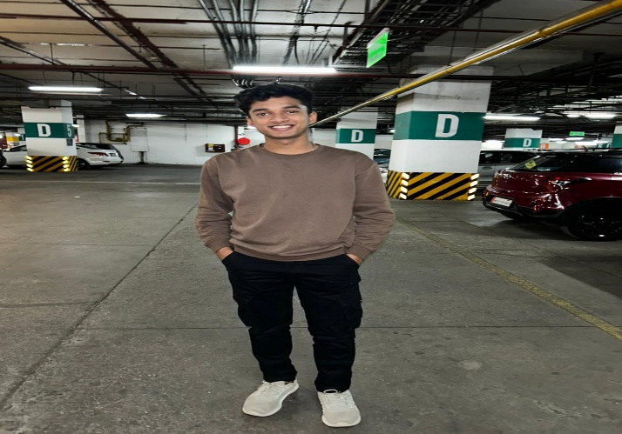
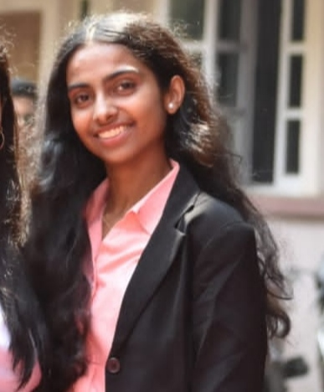
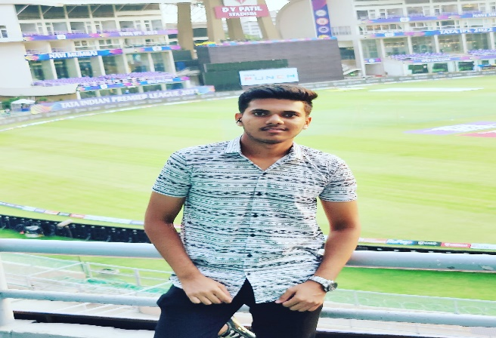

The Senior Council
Secretary
The Senior Council

Slide 5
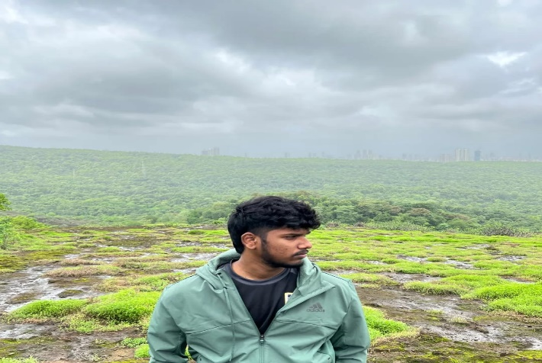
The Junior Council

Slide 6
Sports Offered
VESIT Premier League (VPL): Where Football Takes Center Stage!
VPL, or VESIT Premier League, is the ultimate celebration of football excellence right here at VESIT. It's an 11-a-side football extravaganza where the thrill of the game knows no bounds.
Key Highlights of VPL:
8 Teams, 1 Glorious Title: VPL brings together 8 formidable teams, each vying for the illustrious VPL championship. The excitement is palpable, and the competition is fierce.
Captain's Auction: Here's where strategy and sportsmanship converge. Team captains become auctioneers, handpicking their squad members through an electrifying auction process. It's a true test of their footballing acumen.
Round Robin Tournament: VPL follows a captivating round-robin format. Every team faces off against each other, ensuring a well-fought match for each fixture. Goals, teamwork, and sheer determination will determine the victors.

Slide 7
Sports Offered
VCL: Where Cricket Meets Excellence!
Key Highlights of VCL:
8 Teams, 1 Coveted Title: VCL assembles 8 formidable cricketing squads, each with its eyes set on the prestigious VCL championship. The competition is fierce, and the cricket is nothing short of exceptional.
Captain's Auction: Prepare for high-stakes drama as team captains turn into cricket strategists. Through a captivating auction process, they'll handpick their teammates, creating a dream team with a winning vision.
Round Robin Showdown: VCL follows an enthralling round-robin format. Every team faces off against each other, guaranteeing thrilling matches that keep you on the edge of your seat. Boundaries, wickets, and spectacular catches will decide the victors.

Slide 8
Sports Offered
VESIT Table Tennis League (VTL): Where Precision Meets Passion!
Key Highlights of VTL:
The Battle of Paddles: VTL brings together skilled table tennis players from across VESIT, uniting them in an epic battle of paddles. It's where the tiniest flick of the wrist can make all the difference.
Individual Glory and Team Spirit: While table tennis is often seen as an individual sport, VTL fosters camaraderie. Players compete not just for personal glory but also to contribute points for their team. It's a balance between individual excellence and team dynamics.
Varied Skill Levels: Whether you're a seasoned table tennis pro or just discovering your love for the sport, VTL caters to all skill levels. It's the perfect platform to sharpen your skills and challenge yourself.
Thrilling Matches: VTL follows a competitive round-robin format, where every participant faces off against others. Each match is an exhilarating exchange of swift serves, precise shots, and nimble footwork.

Slide 9
Sports Offered
"VFL: Where Futsal Dreams Take Flight!“
Key Highlights of VFL:
Captain's Role: VFL is unique because team captains play a pivotal role in shaping the league. Every year, four captains are selected from each academic year - TE (Third-Year), SE (Second-Year), and BE (Fourth-Year) students, forming the backbone of VFL.
Team Selection: It's not just about who's on your team; it's about who you choose. Captains become auctioneers, strategically selecting their squad members in an exhilarating auction process. The choices they make can make or break a team.
Group Stage & Knockouts: VFL features an intense group stage followed by knockouts. Teams go head-to-head in a round-robin format during the group stage, where every match counts. The best teams advance to the knockout rounds, leading to nail-biting finals.

Slide 10
Sports Offered
Indoor Spurthi: Uniting Branches in a Battle for Supremacy!
Key Highlights of Indoor Spurthi:
Interbranch Showdown: Indoor Spurthi brings together students from every branch in a thrilling battle for the Spurthi championship. It's where branches unite to compete, showcasing their skills and sportsmanship.
A Diverse Array of Indoor Sports: From table tennis to carrom, darts, and chess, Indoor Spurthi offers a diverse lineup of indoor sports. Each branch selects its best players to participate, creating a dynamic and competitive atmosphere.
Branch Rivalry: The event fosters healthy rivalry among branches, where bragging rights and the Spurthi championship are at stake. It's a chance for branches to prove their athletic prowess and establish dominance.

Slide 11
Sports Offered
Outdoor Spurthi: Where the Great Outdoors Become Your Playground!
Key Highlights of Outdoor Spurthi:
A Medley of Outdoor Sports: Outdoor Spurthi offers a thrilling mix of outdoor sports, including football, cricket, kho kho, volleyball, and tug of war. It's a sports enthusiast's dream come true, with something for everyone.
Interbranch Challenge: Just like Indoor Spurthi, Outdoor Spurthi is an interbranch competition. Each branch fields its finest athletes to compete in various outdoor sports, vying for the coveted Spurthi championship.
Branch Rivalries: The event ignites spirited rivalries among branches as they compete across different sports. The battles on the field are a reflection of branch pride and determination.

Slide 12
Upcoming Events
Get Ready for Exciting Upcoming Sports Events at VESIT!
Hello Fellow Sports Enthusiasts,
Get ready to mark your calendars because the VESIT Sports Council is thrilled to announce a series of thrilling upcoming sports events that are set to keep you on the edge of your seats. Here's a sneak peek at what's in store:
Indoor Spurthi - Celebrate Indoor Sports Excellence!
VESIT Premier League (VPL) - Football Fever!
VESIT Cricket League (VCL) - Cricketing Excellence Awaits!
Outdoor Spurthi - Embrace the Great Outdoors!

Slide 13
Achievements of the Council

Slide 14
Perks of joining the Council
Unlock the Perks of Joining the VESIT Sports Council!
Camaraderie: Sports have a unique way of bringing people together. You'll build strong bonds and friendships with fellow members who share your passion for sports. It's a close-knit community that supports and motivates each other.
Leadership Development: The Sports Council provides opportunities to take on leadership roles. You can become a captain, organizer, or even the president, honing your leadership and organizational skills.
Event Management: You'll gain valuable experience in organizing and managing sports events. This is not only a resume booster but also a chance to learn essential event planning and execution skills.

Slide 15
Perks of joining the Council
Unlock the Perks of Joining the VESIT Sports Council!
Stress Relief: Sports provide an excellent outlet for stress relief. After a challenging day of classes, there's nothing like a game of your favorite sport to unwind and relax.
Fun and Enjoyment: Above all, the Sports Council promises fun and enjoyment. You'll create lasting memories, share countless laughs, and enjoy the thrill of competition.
Lifelong Passion: Many members discover a lifelong passion for sports through their involvement with the Sports Council. It's not just about your time at VESIT; it's a journey that can continue throughout your life.

Slide 16
How to Get Involved

Slide 17
Contact Info

Slide 18
Questions & Answers
Exclusive Sports Q&A Session for First-Year Students (FEs): Your Sports Questions, Our Answers!
Are you a sports enthusiast eager to learn more about sports activities, events, and opportunities at VESIT? Or perhaps you have questions about joining the Sports Council and participating in sports events? We're here to provide you with answers and insights tailored to your sports interests!
This session is your chance to dive deep into the world of sports at VESIT. Whether you're curious about sports clubs, upcoming tournaments, fitness facilities, or how to get involved, the sports council is ready to assist you.

Slide 19
Thank You!
Thank You for an Enthusiastic Induction, FEs!
Hello First-Year VESIT Students (FEs),
We extend our heartfelt gratitude to each one of you for being a part of our Induction Session. Your presence, curiosity, and enthusiasm made the event truly special.
Your active participation and keen interest in getting to know the Sports Council and our offerings were remarkable. We appreciate your engaging questions, your willingness to learn, and your passion for sports.
As you embark on your journey at VESIT, we hope that the information and insights you gained during the induction will be valuable as you explore the world of sports within our campus.
Remember, the Sports Council is here to support and encourage you in your sports endeavors throughout your time at VESIT. We're excited about the prospect of seeing you on the field, participating in our events, and being part of our vibrant sports community.
Once again, thank you for your active involvement in the Induction Session. We look forward to meeting you at our upcoming sports events and activities.
If you have any further questions or need assistance, feel free to reach out. Let's make your sports journey at VESIT an unforgettable one!

Slide 20
VESIT SPORTS COUNCIL

